Slide 1
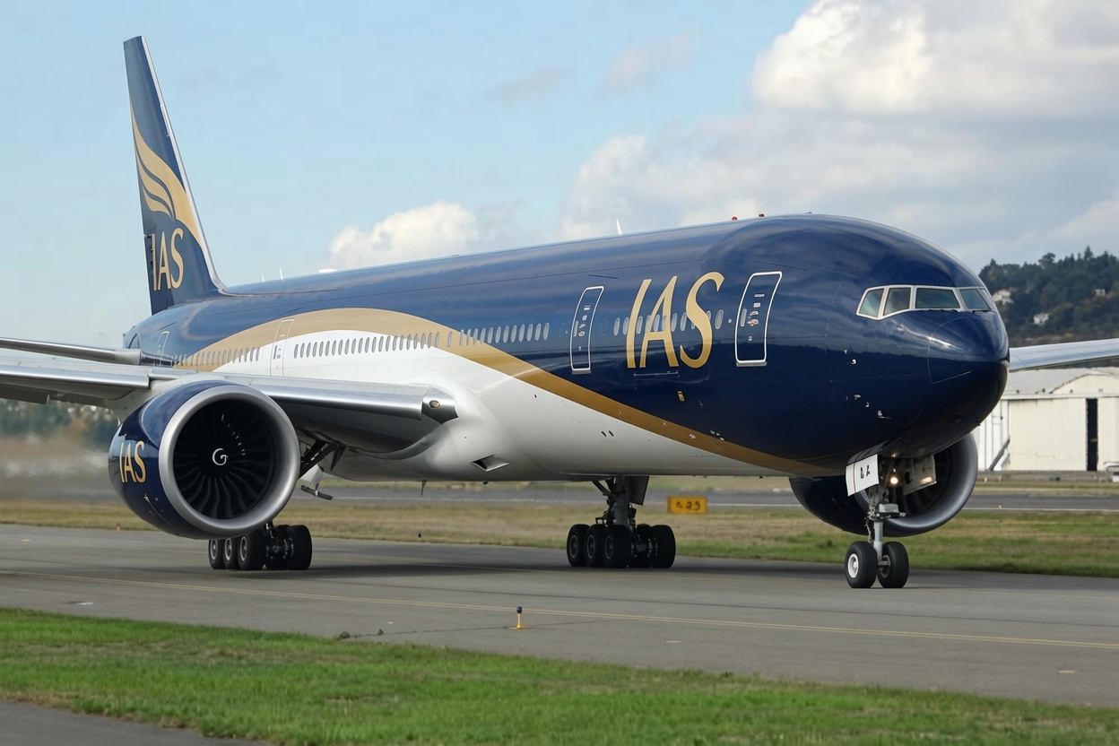
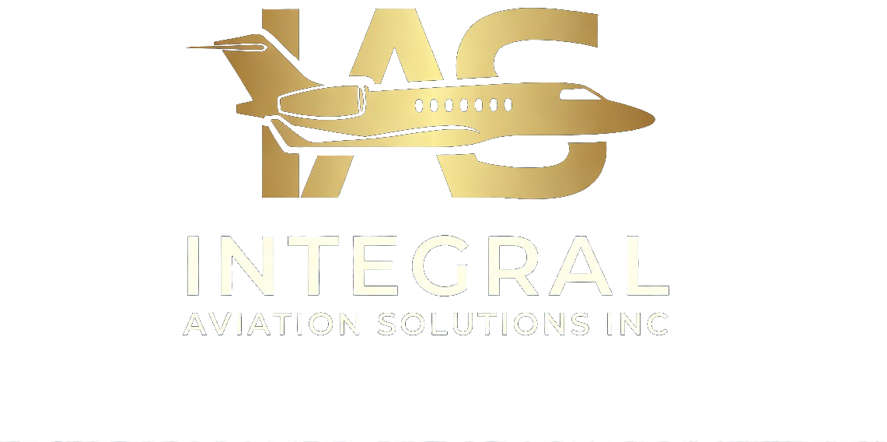
A CONFIDENTIAL ADVISORY PROPOSAL
Acquiring Your First Private Aircraft
Independent Boeing Business Jet & Airbus Corporate Jet advisory — protecting your interests from first conversation to first flight.
ASSET INTELLIGENCE. ADVISORY PRECISION. · SINCE 1985

Slide 2
THE DECISION AHEAD
A first aircraft is a nine-figure decision made in a market built for repeat insiders.
Acquiring a BBJ or ACJ is unlike any other purchase a principal makes. The aircraft are complex, the records are unforgiving, and nearly everyone at the table is paid to close the deal — not to protect you.
INTEGRAL AVIATION SOLUTIONS INC
02 / 12

Slide 3
WHAT FIRST-TIME BUYERS DON'T SEE
Three Risks Hidden Beneath the Surface
01
02
03
UNDISCLOSED HISTORY
INFLATED VALUATION
CONFLICTED ADVICE
Damage history, deferred maintenance, and incomplete records that surface only under expert technical scrutiny — long after the deposit is paid.
Asking prices anchored to optimism, not to airframe condition, market comparables, or the true cost of bringing an aircraft to standard.
Brokers and intermediaries earning commission from the seller, carrying inventory to move, and incentivised to close rather than to caution.
INTEGRAL AVIATION SOLUTIONS INC
03 / 12

Slide 4

WHO WE ARE
Independent Consultants. No Conflicts.
Integral Aviation Solutions Inc operates as independent Boeing Business Jet and Airbus Corporate Jet consultants. We carry no inventory, represent no manufacturers, and earn no commissions from third parties. Our sole obligation is to you.
120+
4
COMBINED YEARS EXPERTISE
CONTINENTS OF ACTIVE WORK
Zero
1985
CONFLICTS OF INTEREST
YEAR ESTABLISHED
INTEGRAL AVIATION SOLUTIONS INC
04 / 12

Slide 5
WHY INDEPENDENT
The Broker Sells. We Advise.
THE CONVENTIONAL BROKER
INTEGRAL AVIATION SOLUTIONS INC
Embedded Conflicts
Your Interest, Exclusively
Earns commission from the seller
Carries inventory that must be moved
Incentivised to close, not to protect
Opaque fees and referral arrangements
Retained by the buyer, and only the buyer
No inventory, no manufacturer ties
Operational depth — captains & engineers
Transparent fees, under strict confidence
INTEGRAL AVIATION SOLUTIONS INC
05 / 12

Slide 6
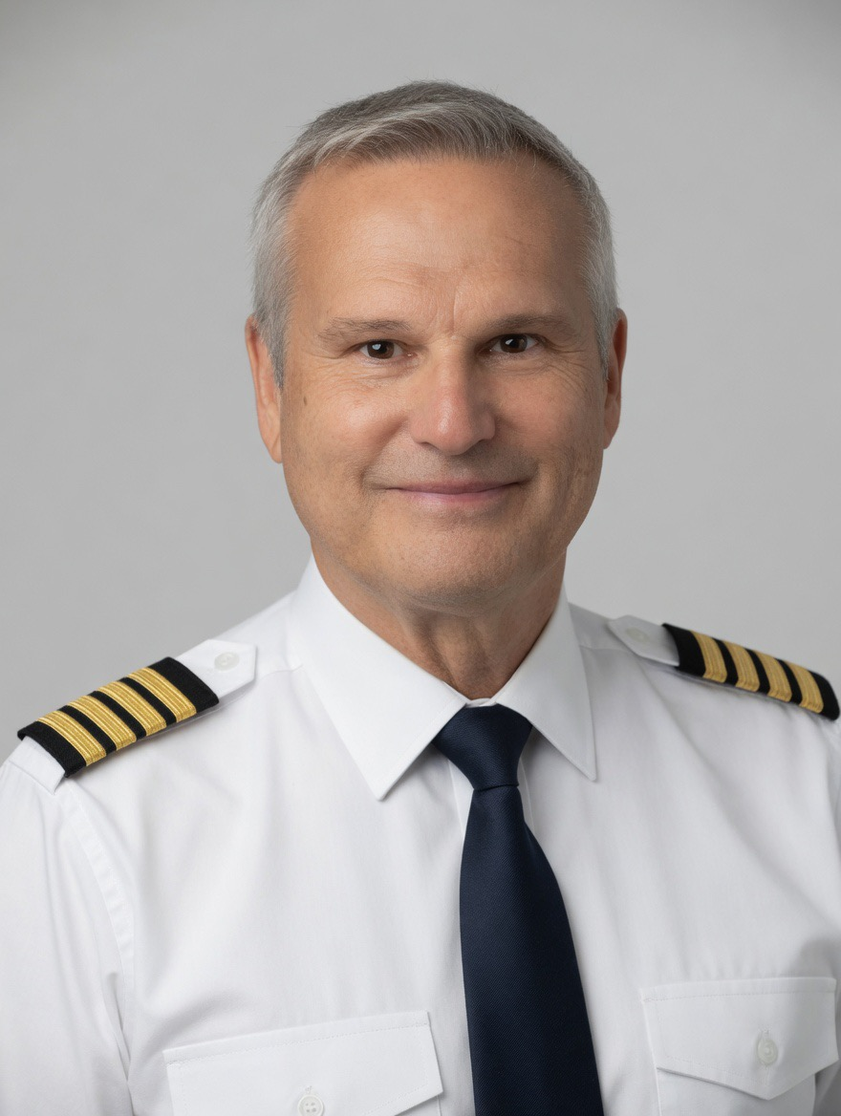
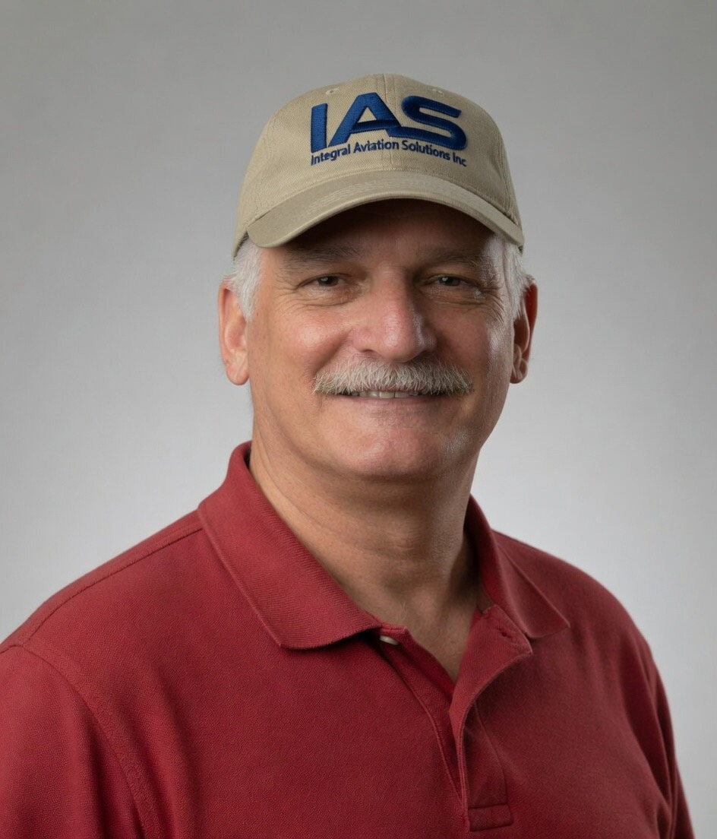
WHO REPRESENTS YOU
Professionals Who Built Careers in Aviation
Capt. Ivan Klugman
Michael Bonventre
PRINCIPAL ADVISOR
SENIOR TECHNICAL ADVISOR
Thirty-five years of wide-body airline operations behind every engagement — representation from someone who has flown the aircraft and stood on the hangar floor.
Decades of airframe engineering, records auditing, and FAA designation — the technical conscience of every acquisition, completion, and valuation we undertake.
RETIRED AIRLINE CAPTAIN
COMMERCIAL ATP
FAA DAR-T APPOINTEE
NAAA SENIOR APPRAISER
VIP ACQUISITION
HEAD OF STATE AIRCRAFT
USPAP CERTIFIED
A&P MECHANIC
INTEGRAL AVIATION SOLUTIONS INC
06 / 12

Slide 7
WHAT SETS US APART
Asset Intelligence at Every Stage
—
—
OPERATIONAL DEPTH
FAA DAR-T AUTHORITY
Advisors who built careers within aviation — not consultants who studied it from the outside.
Airworthiness certificates issued directly for international transactions, without FSDO routing.
—
—
NAAA-STANDARD VALUATION
ABSOLUTE CONFIDENCE
Independent appraisals relied upon by financiers and institutions worldwide.
Every engagement handled under strict professional confidentiality, from first call onward.
INTEGRAL AVIATION SOLUTIONS INC
07 / 12

Slide 8
ADVISORY SERVICES
Concept to Flight — The Full Lifecycle
01
02
03
ACQUISITION
COMPLETIONS
INTERIORS
Buyer-side BBJ & ACJ representation and pre-purchase inspection management.
Completion management protecting schedule, budget, and specification.
VVIP interior design from concept to FAA-approved, certified cabin.
04
05
06
ASSET MANAGEMENT
LEASE & REDELIVERY
FAA & DAR-T
Airworthiness oversight, records, and value reporting for owners.
Independent technical representation through lease transitions.
Airworthiness certification and export/import documentation.
INTEGRAL AVIATION SOLUTIONS INC
08 / 12

Slide 9
YOUR ACQUISITION JOURNEY
How We Work With You
STEP 01
STEP 02
STEP 03
STEP 04
Confidential Call
Mission & Mandate
Search & Shortlist
Inspection & Close
We listen. You describe the mission, the ambition, and the constraints — in complete confidence, with no obligation.
We translate your needs into a precise mission profile and aircraft specification, then define the search mandate.
We canvass the global market, screen candidates on condition and value, and present a defensible shortlist.
We manage the pre-purchase inspection, negotiate on evidence, and see the transaction through to delivery.
INTEGRAL AVIATION SOLUTIONS INC
09 / 12

Slide 10
Our advisors are not consultants who studied aviation — they are professionals who built careers within it.
120+ YEARS COMBINED · FAA DAR-T · NAAA SENIOR APPRAISER
INTEGRAL AVIATION SOLUTIONS INC
10 / 12

Slide 11
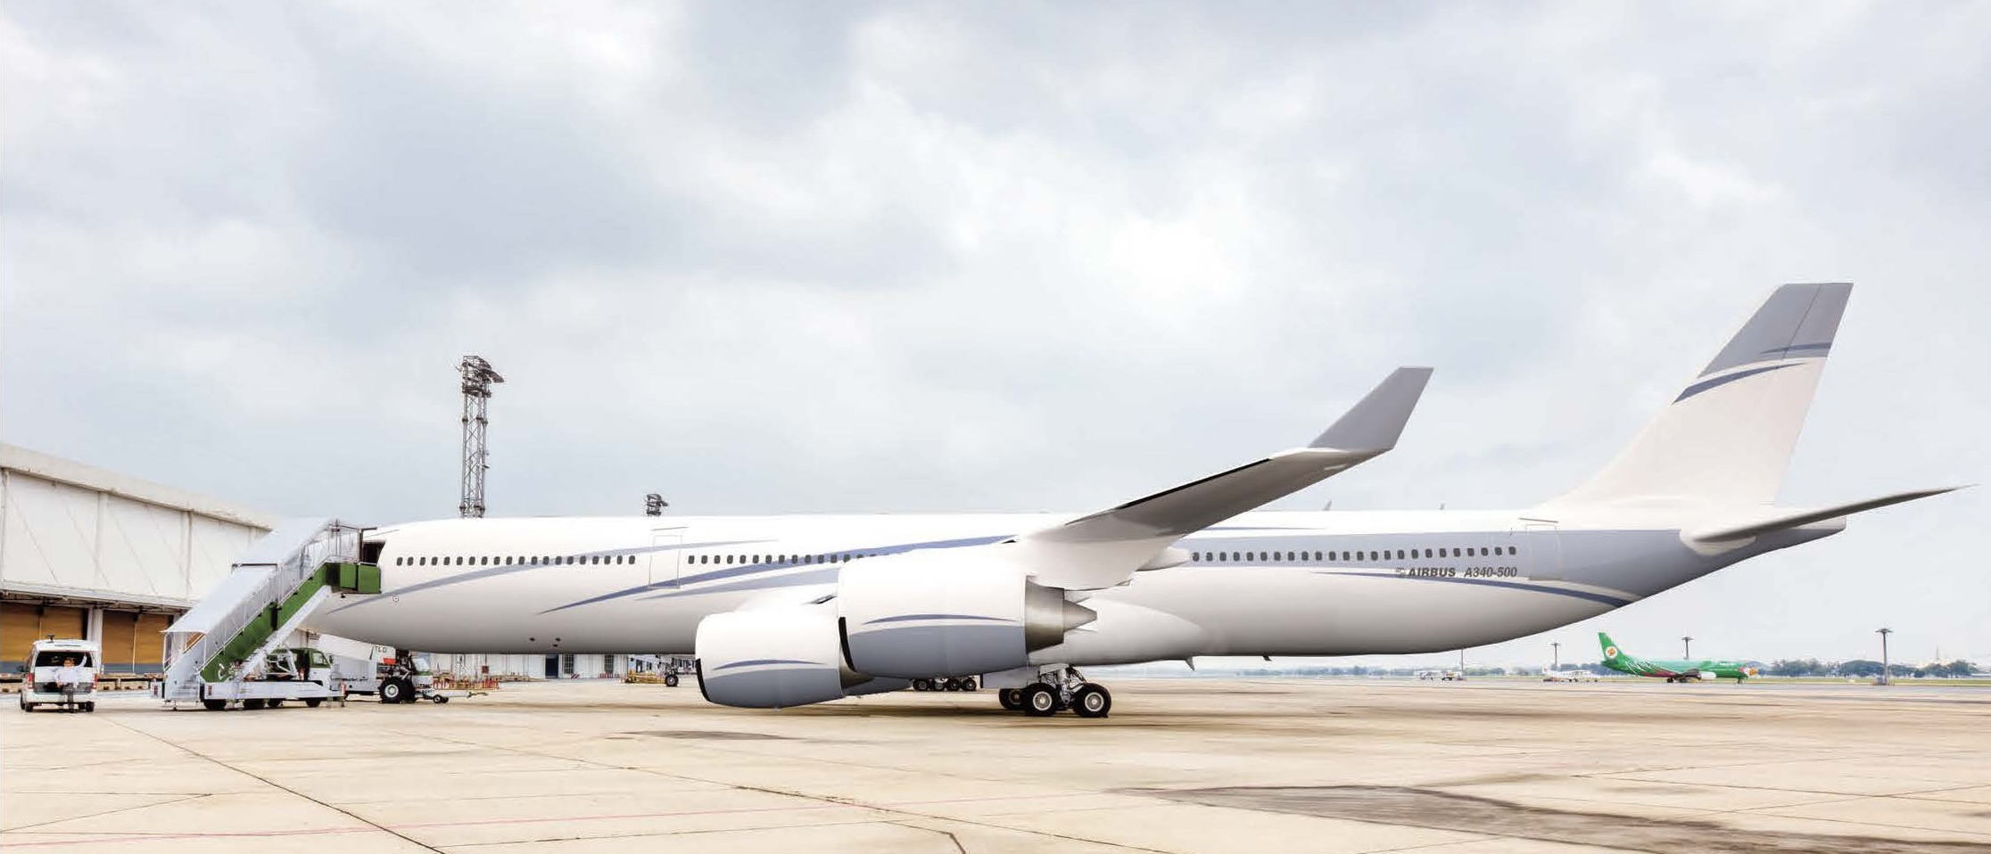
GLOBAL REACH
Trusted Across Four Continents
From private principals to heads of state and sovereign governments, our mandates span the globe — wherever discretion and technical certainty are required.
40yr
4
BBJ·ACJ
Zero
OF ADVISORY PRACTICE
CONTINENTS OF ACTIVE WORK
PLATFORM SPECIALISTS
CONFLICTS OF INTEREST
INTEGRAL AVIATION SOLUTIONS INC
11 / 12

Slide 12
INDEPENDENT. EXPERIENCED. CONFIDENTIAL.
Your Aircraft. Our Full Attention.
TELEPHONE
BEGIN
REACH
1.561.809.8606
A confidential, no-obligation conversation
Worldwide · Four Continents
ASSET INTELLIGENCE. ADVISORY PRECISION.
12 / 12

